Slide 1


Slide 2
Outline
Introduction to Programming
Statements
Expressions
Output
Input
Operators
Values & Types

Slide 3
Statements

Slide 4
Variables are symbolic placeholders for values.
There are three kind of declarations in JS (ES6):
var - declares a variable, optionally initializing it to a value.
let - declares a block-scoped, local variable, optionally initializing it to a value.
const - declares a block-scoped, read-only named constant.

Slide 5
JS identifier must start with a letter, underscore (_), or dollar sign ($); subsequent characters can also be digits (0-9) e.g. var fooBar, var _fruits, var $dollar100
JS is case sensitive, letters include the characters "A" through "Z" (uppercase) and the characters "a" through "z" (lowercase).
A variable declared using the var or let statement with no assigned value specified has the value of undefined.

Slide 6
Statement is a group of words, numbers, and operators that perform a specific task.
In JS, statements conclude with a semicolon ;
A group of statements is a program.

Slide 7
var foo;
let fruits = [ ];
const b = 3;
var a = b * 2;
a and b are variables
2 is a literal value
= and * are operators

Slide 8
Expressions

Slide 9
An expression is a reference to a variable or value within statement that contains an operator. For example
var a = b * 2
alert(a);
2 is a literal value expression
b is a variable expression
b * 2 is an arithmetic expression, which means to the multiplication
a = b * 2 is an assignment expression, which means to assign the result of the b * 2 expression to the variable a
alert() is a function call expression statement

Slide 10
For the computer to understand your code (group of statements), they have to be translated either by an interpreter or a compiler.
Interpreter translates the code from top to bottom, line by line, each time the program is executed.
Compiler translates the code ahead of time before the program is executed
JS engine compiles a program on the fly and then immediately runs the compiled code.
TIP: On developer console, to type multiple lines press shift + enter

Slide 11
Output

Slide 12
The DOM console has a console object that provides access to the browser's developer console.
To print text or output to the user in the developer console, we use the command console.log()
var welcome = 'hello world';
console.log(welcome);
log() is a function call expression that handles the welcome variable and prints it to the console.
Notes:
Document Object Model (DOM) is a programming API for HTML and XML documents. It defines the logical structure of documents and the way a document is accessed and manipulated. https://www.w3.org/TR/1998/WD-DOM-19980720/introduction.html

Slide 13
Other console object methods include:
clear() - clears the console
error() - outputs an error message to the console
info() - outputs an informational message to the console
warn() - outputs a warning message to the console
table() - displays tabular data as a table
Other ways, you can output is through DOM window methods such as:
alert() - displays an alert box with a message and an OK button
confirm() - displays a dialog box with a message and an OK and a Cancel button

Slide 14
Input

Slide 15
To receive information from the user, we use DOM window object method prompt()
name = prompt("What is your name?");
console.log(name);
Alternatively, you could create HTML input elements and use JS to read those values into your program variables.

Slide 16
Operators

Slide 17
Assignment: = as in `var a = 5`;
Arithmetic: + (addition), - (subtraction), * (multiplication), and / (division), as in `a * 3`.
Compound Assignment: +=, -=, *=, and /= are compound operators that combine a math operation with assignment, as in a += 2 (same as a = a + 2).
Increment/Decrement: ++ (increment), -- (decrement), as in a++ (similar to a = a + 1).
Object Property Access: . as in console.log().
Equality: == (loose-equals), === (strict-equals), != (loose not-equals), !== (strict not-equals), as in a == b.

Slide 18
Comparison: < (less than), > (greater than), <= (less than or loose-equals), >= (greater than or loose-equals), as in a <= b.
Logical: && (AND), || (OR), ! (NOT) as in a || b that selects either a or b.
Conditional (ternary): condition ? val1 : val2 as in js_marks >= 80 ? 'pass' : 'fail';
Unary: delete e.g. var b = 3; delete b; typeof e.g. typeof b;
Relational: in e.g. propNameOrNumber in objectName , instanceof e.g. objectName instanceof objectType

Slide 19
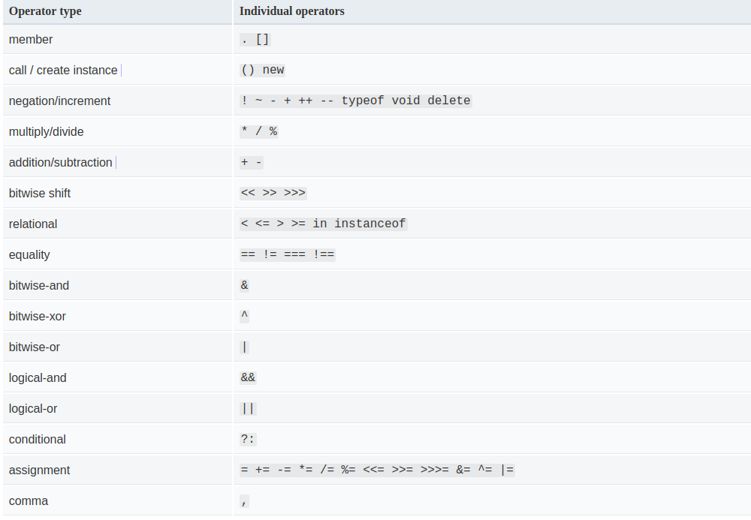
Operator Precedence
Source: https://developer.mozilla.org/en-US/docs/Web/JavaScript/Guide/Expressions_and_Operators#Operator_precedence

Slide 20
Values and Types

Slide 21
ES6 defines the following seven data types:
Boolean. true and false.
null. A special keyword denoting a null value. Because JS is case-sensitive, null is not the same as Null, NULL, or any other variant.
undefined. A top-level property whose value is not defined.
Number. An integer or floating point number e.g. 99,
String. A sequence of characters that represent a text value e.g. "Hello"
Symbol (new in ES6). A data type whose instances are unique and immutable.
Object named containers for values.
Source: https://developer.mozilla.org/en-US/docs/Web/JavaScript/Guide/Grammar_and_Types#Data_types
Notes:
First six data types are primitives.

Slide 22
Next class
Introduction to Programming
Converting Between Types
Code Comments
Variables
Blocks
Conditionals
Loops
Functions
Scope
Course material: https://github.com/getify/You-Dont-Know-JS/blob/master/up%20%26%20going/ch1.md

